Slide 1
Relation Extraction in Clinical Text using NLP
Based Regular Expressions
Summary of paper of -
Veena G, Hemanth R, Jithin Hareesh
Department of Computer Science and Applications, Amrita Vishwa Vidyapeetham, Amritapuri, India
By Sunil J Gauda

Slide 2

Context
Extracting relations from unstructured or semi structured clinical data using NLP and Regular Expressions

Slide 3
Process
Data Extraction
Data Processing
Relationship Extraction

Slide 4


1. Data Extraction
Extracting Data to extract relations between them.
Web Scraping Scraping from internet directly using tools.
Crawlers Creating web crawlers to get the data from the websites and store it in databases.

Slide 5
2. Data Processing
Processing Data to prepare them to extract relationship front them.
Regular Expressions Regular Expressions are used to extract data from the scraped raw data, we can remove special characters and any undesired values as required with specified patterns.
Part-Of-Speech Tagging with Labeling Tagging nouns in the speech as nouns are the bases of relationship extraction in the paper and labeling created unique tags for each noun.

Slide 6
3. Relationship Extraction
Extracting Relationship from nouns to create a elaborate network of data that helps explore the domain using keywords.
Path Similarity Analysis Finding Relationship between nouns to create relationships between them. Like looking for a skin patch one could find the relation between skin problem and other issues with it.

Slide 7
Gap
Related Work
Work Done
Missing Points

Slide 8
1.1. Related Work
Relationship Extraction were done on different context and this paper is built upon those work.
A. Mykowiecka, M. Marciniak and A. Kupsc Data Retrieval System using mammogram reports and Clinical Records
X. Fu and S. Ananiadou concept extraction and entity identification system which uses machine learning

Slide 9
1.2. Related Work
Relationship Extraction were done on different context and this paper is built upon those work.
W. T. Abdel-moneim, M. H. Abdel-Aziz, and M. M. Hassan Data Retrieval System using mammogram reports and Clinical Records
D. Demner-Fushman and J. Lin knowledge extraction which can be used for question answering
B. Rink, S. Harabagiu, and K. Roberts Clinical Text Relationship Extraction using ML

Slide 10
2.1. Work Done
Using the data extracted from web, the paper shows how relationship can be established using modern libraries which were not used in previous work that was done on it.

Slide 11
2.2. Library’s
Word-net database - English Words
Regular expression - python internal Package
Meta-Map - Medical Words

Slide 12
3. Missing Points
Missing Implementation Details is a small thing that is missing with the paper.
Python Implementation Details Only Regx Sample was provided no python library details were added
POS and Labelling Tools The major key role is played when the data is modeled using POS and Sampled using Labelling, How its done mathematically or programmatically is not specified.
Path Math Problem Math behind Path Identification which is the last part of the paper is not specified,

Slide 13
Target and The Starting Point
Relationship Extraction between Medical Terms.
The Relationship was found using medical text from the internet.
The Relationship extracted helps identifying related symptoms of diseases with related conditions and terms that are mentioned in the clinical texts.
This will help doctors and medical staff to diagnose better and faster, and pace with growing healthcare needs.

Slide 14
How it is implemented
The Implementation Details of the Paper which was used to achieve the desired result.

Slide 15
The 6 Steps
Input Data
Reg-X
POS
Meta Map
Labeling
Classified Data

Slide 16
Result’s
The data collected contains nouns that are singular and plural in nature.
It contains symptoms, parts of body i.e Organs, Treatment and names of diseases with relations between them.

Slide 17
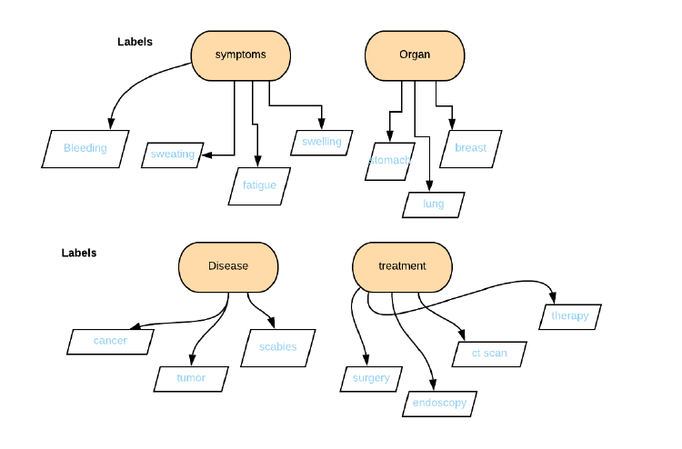
Answer ?

Slide 18
Significance
It Contributes to Health Science with Faster Disease Identification, Reduced Diagnosis time, Correct Treatment Selection - As Process can be Experimental and are prone to trials and errors.
Contribution is Unique by the bay of implementation of the POS, and Labelling Techniques.
It Provides a Great source of inspiration for using the techniques for non medical projects in the domain of physics and computer science where it can help reduce experimentation time.
We can see a drastic increase in projects which implements similar logic using Image recognition, and pharmaceutical data for medicine recommendation with increasing treatment processes.

Slide 19
Thank You !

